Slide 1
Implementing Fiscal Decentralization in Sierra Leone Presentation By Alpha Umaru Jalloh Ag. DIRECTOR Local Government Finance Department, Ministry of Finance & Economic Development 9th May 2014

Slide 2
Presentation Outline
Objective of SL’s Fiscal Decentralization (FD)
Requirements of a good Fiscal Decentralization System- What we have achieved
Addressing FD Challenges

Slide 3
Objective of FD
Four pillars: Expenditure assignment, Revenue assignment, Intergovernmental transfer and Local Borrowing.
The primary objective:
Local Councils are adequately funded to perform their functions;
decentralization does not result to deterioration in the quality and quantity of service delivery at the local level; and
Local Councils raise substantial amount of revenue from their local sources.

Slide 4
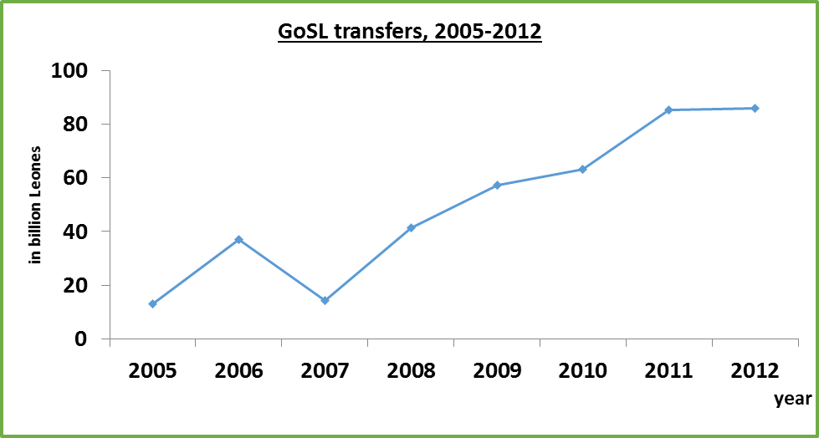
Fiscal Transfer Trends

Slide 5
Own revenue Sources
Revenue Sources | (In Million Leone)
Local revenues | 2005 | 2006 | 2011 | 2012
Tax Revenue | 11.7 | 1,388.27 | 5,806.37 | 5,774.24
Local tax | 425.95 | 528.54 | 298.32 | 258.17
Property tax | 1,017.35 | 859.73 | 5,508.05 | 5,516.07
Non tax Revenue | 18.2 | 4,198.66 | 7,816.39 | 8,095.77
Fees and charges | 4.20 | 2,427.51 | 3,972.08 | 3,764.91
Market dues | 0.00 | 1,921.08 | 2,629.02 | 2,452.84
Other fees and charges | 4.20 | 506.43 | 1,343.06 | 1,312.07
Business registration | 3.00 | 37.01 | 75.97 | 142.37
Business Licenses | 9.00 | 470.67 | 2,527.36 | 2,547.71
Mining revenues | 0.00 | 1,165.03 | 1,132.92 | 1,344.53
other local revenues | 2.00 | 98.44 | 108.06 | 296.25

Slide 6
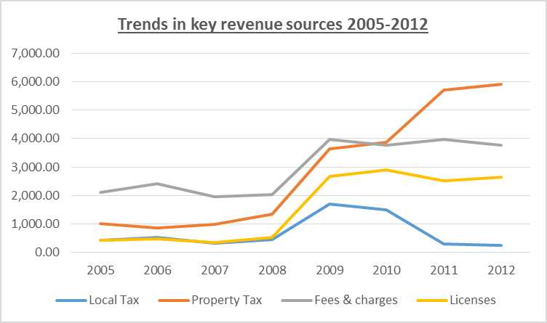
Own Revenue Trends

Slide 7
2. Requirements of a good FD System
High measure of fiscal decentralization- measure devolved expenditures and revenues that run through the accounts of Local Councils
Sierra Leone:
46.3 % of Public expenditure is used to support the delivery of local services
6.9% of resources are actually channeled through LCs. E.g. in education 9.3% of spending is done by LCs; 79.7% is directed towards the local level through MEST, mostly in spending on salaries of teachers, school staff, and education administrators who work at local level

Slide 8
2. Requirements of a good FD System
Sound intergovernmental grants systems- grant system that aims to improve the efficiency and equity with which resources are allocated, and should further increase the fiscal autonomy of LCs.
SL is Implementing a ‘second generation’ intergovernmental grants systems- links finance to function through a client-based expenditure norm and affordable service delivery

Slide 9
2. Requirements of a good FD System
Characteristics of the grant system;
Modified Structure of the intergovernmental fiscal transfer system to meet best standards
Addresses apparent vertical imbalances- finance follows functions
Equitable distribution of resources among councils
nature of intergovernmental transfers viv-a-vis budget outlays

Slide 10
2. Requirements of a good FD System
Modified Structure of the intergovernmental fiscal transfer system to meet best standards
A. Recurrent non-wage grants
1. Sectoral recurrent non-wage expenditures for devolved and delegated functions.
1a. Health grants (primary and secondary)
1b. Education grants (primary and junior secondary)
1c. Water Services Grant
1d. Agriculture grants
2. Grants for Administration and Other (Exclusively) Local Functions are bulked as one unconditional grant

Slide 11
2. Requirements of a good FD System
B. Recurrent wage grants
3. Sectoral wage grants – yet to be achieved
4. Administrative wage grant- core staff salaries
C. Local Development Grants
5. Discretionary LGDG- ongoing
6. Sectoral development window under LGDG- not in existence
6a. Education development grant window
6b. Health development grant window
6c. Rural water development grant window
6d. Urban development grant window
6e. Other sectoral development grant windows as appropriate

Slide 12
2. Requirements of a good FD System
Addressing apparent vertical imbalances- finance follows functions
Finance should follow functions through a system of client-based expenditure norms which are linked to affordable service delivery standards.
A devolution costing is ongoing to determine full implement cost of functions devolved to LCs

Slide 13
2. Requirements of a good FD System
Addressing apparent vertical imbalances- finance follows functions
Finance should follow functions through a system of client-based expenditure norms which are linked to affordable service delivery standards.
A devolution costing is ongoing to determine full implement cost of functions devolved to LCs

Slide 14
2. Requirements of a good FD System
Equitable distribution of resources among Councils
Allocation formula:
i. Primary Health- Lump sum; population (adjusted for demand for primary health services)- Achieved
ii. Primary education (incl. JSS)- Lump sum; total enrolment (primary/JSS); population- Achieved
iii. Agriculture sector- Lump sum; share of arable land; population engaged in crop farming; livestock population; (forestry?)- Achieved but forestry
iv. Water services- Lump sum; rural population- Achieved

Slide 15
2. Requirements of a good FD System
Nature of intergovernmental transfers – budgetary transactions rather than budgetary exchange
Transfers to LCs should be treated as budgetary transaction rather than budgetary exchange. LCs should not be required to provide detailed reports to MOFED within the budgetary year how the previous quarter’s release was spent before triggering the next grant release
This is difficult to adopt. Sector transfers form part of the sector national allocations, triggers for national sector spending; GBBA requirement for funds spent from CRF

Slide 16
3. Addressing the Challenges
1. Low measure of fiscal decentralization
Devolving procurement of TLM to LCs since this is not too technical to handle.
Design a phasing out process for devolution of payroll, as well as teacher’s salaries through LCs.
Identify other resources that are easy to channel through LC systems
2. Sound intergovernmental grants systems
Completing the devolution costing, including personnel and asset requirements

Slide 17
3. Addressing the Challenges
3. Modifying the structure of the intergovernmental fiscal transfer system
Sectoral wage grants- phasing the process of paying salaries of devolved personnel assigned to LCs
Reviving the LGDG scheme- introduction of sectoral development grants
4. Addressing the apparent vertical imbalances
Completing the devolution costing- establishing the true cost of service delivery, taking into consideration unfunded mandates and change in scope of devolved functions such as FHC, A4P, etc

Slide 18
3. Addressing the Challenges
5. Improving the equitable distribution of resources among councils
Timely access and availability of data required for variables used in the distribution system
Devolved MDAs must be committed to provide data or proxies as may be required by the system
NGOs and other development partners must used the grant distribution system for funds provided to selected or all LCs
Improving devolved MDA’s oversight of LCs servuce delivery process

Slide 19
Thanks

