Slide 1
Status Update on Decentralization in Sierra Leone Presentation By Alhassan Joseph Kanu DIRECTOR Decentralization Secretariat, Ministry of Local Government & Rural Development 9th May 2014

Slide 2
Presentation Outline
Background to Sierra Leone’s Decentralization
Devolution within the framework of SL Decentralization
Strategies for implementing SL’s Devolution
Status of SL’s Devolution Process
Linking SL’s Devolution to the progress in Local Services Delivery
Challenges faced in implementing SL’s Devolution
The Way Forward for the advancement of SL’s Devolution

Slide 3
Background
The Purpose of Sierra Leone’s Decentralization Programme is to:
promote transparency, accountability, inclusion and prudent public financial management;
reduce conflict by opening up space for political participation (Governance and Development at the door steps of the Local People);

Slide 4
... purpose
improve democratic accountability of the state to citizens and restore citizens’ trust in government; and
reverse the economic downturn and bring about improved service delivery.

Slide 5
Key Elements
The Local Government Act 2004 was passed in March 2004;
A National Decentralization Policy was launched in February 2011.
The hallmark of Sierra Leone’s decentralization is devolution
The first four (4) years (2004 – 2008) of the implementation of the decentralization programme was regarded as a transition period.
design and implement an equitable and transparent intergovernmental fiscal transfer system;

Slide 6
... Key elements
The reorientation and restructuring of Ministries, Departments and Agencies of Government (MDAs) towards their new roles and responsibilities;
Anchoring decentralization on the principles of social accountability and citizens’ participation
Giving prominence to the role of civil society in ensuring proper accountability, transparency and effective citizen participation
Building the capacities of key stakeholders particularly the Local Councils involved in the Decentralization process

Slide 7
2. Devolution within the SL Decentralization Context
Meaning: The transfer of functions with accompanied resources from Central Government (MDAs) to the Local Councils as envisaged in the respective policies and legislation.
Allows for more appropriate, specific-based, effective and efficient delivery of services to the respective localities
Reduces distance between frontline service providers and managers
Enhances greater accountability by service providers to the local people (beneficiaries)
Ensures that money for public services is spread equitably among Local Councils/Districts

Slide 8
3. Strategies to Facilitate Devolution in Sierra Leone
Devolution of functions provided for in Schedule III of LGA 2004 and the SI No. 13 of 2004;
Devolution is a continuous process and not a one-off
MDAs prepared devolution roll out plans;
Devolution commenced in 2005 with the three biggest Ministries – Agriculture, Education and Health;
Opted for Symmetrical devolution;
A Special Account known as Code 701 (Transfers to LCs) was opened in the Ministry of Finance as a transit account to ring-fence devolved funds;
MDAs and LCs to undertake joint verification of assets and personnel followed by formal pronouncement of transfer of functions.

Slide 9
4. Status of Devolution
Administrative/Functional Devolution
15 MDAs to devolve functions and activities to LCs and to date only 9 MDAs have either fully or partially devolved functions to LCs
Eighty (80) functions were slated to be devolved to Councils by end of 2008 but only 37 were devolved by December 2008, and to date 56
Where personnel are available, MDAs have transferred those staff to the LCs but in a de-concentrated fashion
Personnel are still receiving salaries from their parent Bodies
A demand and supply-driven grant introduced for MDAs to facilitate their role in the devolution process

Slide 10
No. | Name of MDA | No. of functions to Devolve | No. of functions Devolved
1 | Ministry of Health and Sanitation | 8 | 7
2 | Ministry of Internal Affairs, Local Government and Rural Development now split into two Ministries | 3 | 3
3 | Ministry of Social Welfare, Gender and Children’s Affairs | 6 | 6
4 | Sierra Leone Roads Authority | 2 | 2*
5 | Ministry of Information and Communication | 2 | 2
6 | Ministry of Mineral Resources & Political Affairs now split into 2 Ministries | 3 | 0
7 | Ministry of Fisheries and Marine Resources | 2 | 2
8 | Administrator and Registrar-General’s Department | 2 | 0

Slide 11
. | Name of MDA | No. of functions to Devolve | No. of functions Devolved
9 | Ministry of Works, Housing, Technical Maintenance and Infrastructure now Ministry of Works Housing and Infrastructure | 2 | 0
10 | Ministry of Lands, Country Planning and the Environment | 8 | 1
11 | Ministry of Education, Youth & Sports now split into three Ministries | 6 | 3
12 | Ministry of Tourism and Culture | 2 | 0
13 | Ministry of Energy and Power now Ministry of Water Resources | 3 | 0
14 | Ministry of Employment, Labour and Social Security now Ministry of Labour and Social Security | 3 | 0
15 | Ministry of Agriculture, Forestry and Food Security | 28 | 28

Slide 12
5. Link between Devolution and Local Services Delivery
Effectiveness of public spending - education
PETS 2001: only 55% school-subsidy grants accounted for by schools. Grants payment was later outsourced to KPMG (10% commission).
PETS 2002: 72% teaching and learning materials reached the intended schools from District Education Offices, arriving 170 days later than contracted.

Slide 13
Link between Devolution and Local Services Delivery
PETS 2003: 60% school furniture reached the intended schools but later than expected.
IRCBP baseline household survey Mar 2005: 58% of people felt that LCs, not the central government, should run the school system.

Slide 14
Link between Devolution and Local Services Delivery
2. Effectiveness of public spending – Health Sector
PETS 2002: less than 10% of all essential drugs could be accounted for by District Medical Officers; less than 5% of all essential drugs were accounted for by periphery health units.
PETS 2003:
97% transfer from CMS to DMOs but only 70% of transfers was accounted for
20% of PHUs did not receive drugs from Central Government

Slide 15
Link between Devolution and Local Services Delivery
“ After devolution, the quality of services did not decline, there have been significant improvements, according to data from a series of national public service and sector (health and education) surveys carried out by Independent Researchers as captured in the publication ‘Decentralization in Post conflict Sierra Leone: The Genie Is out of the Bottle, pg 10 (Srivastava and Larizza, 2011).
Some evidence to show that Decentralization by Devolution has led to improved service delivery

Slide 16
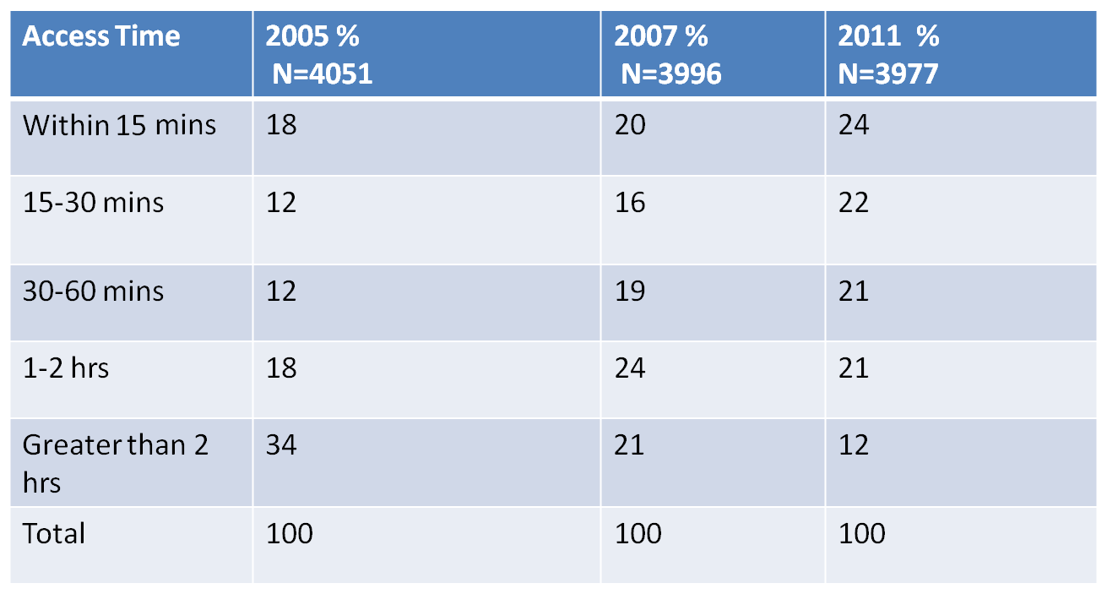
Health: Access to Gov’t Health Facilities

Slide 17
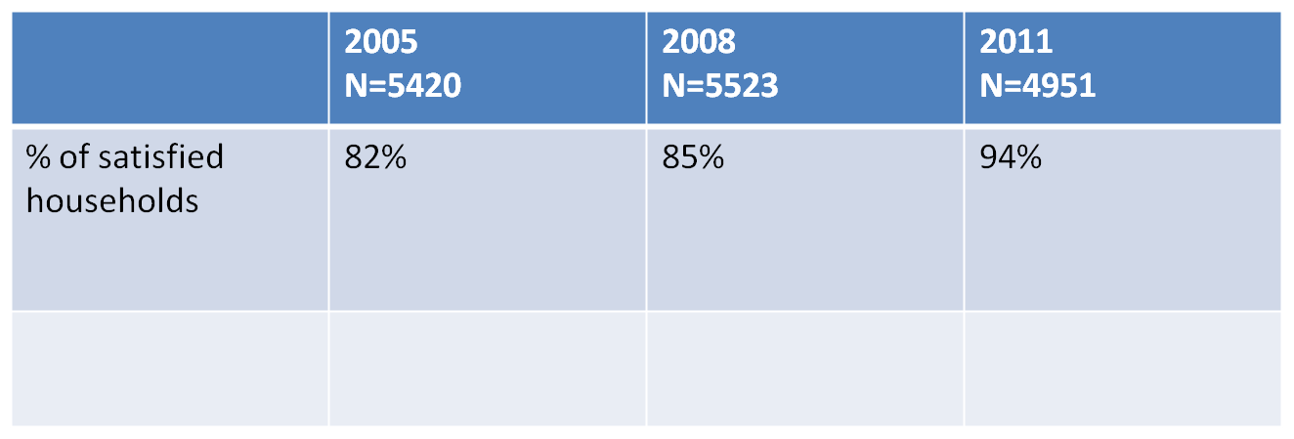
Health: Satisfaction with Health Care in Govt facilities

Slide 18
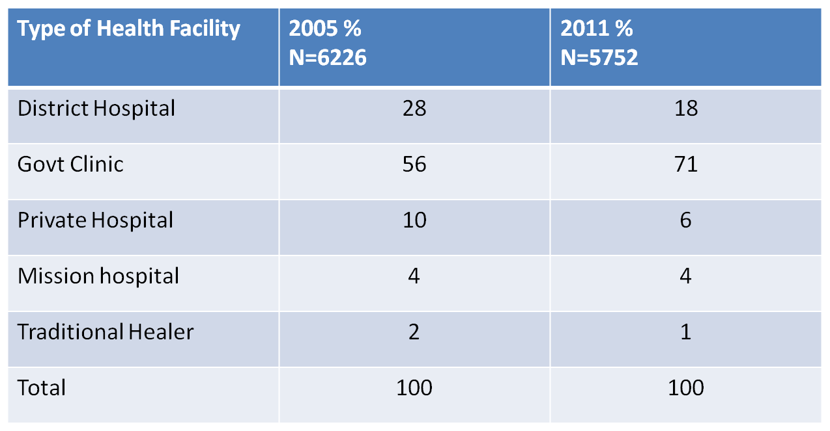
Health: Usual Health Care Provider by year

Slide 19
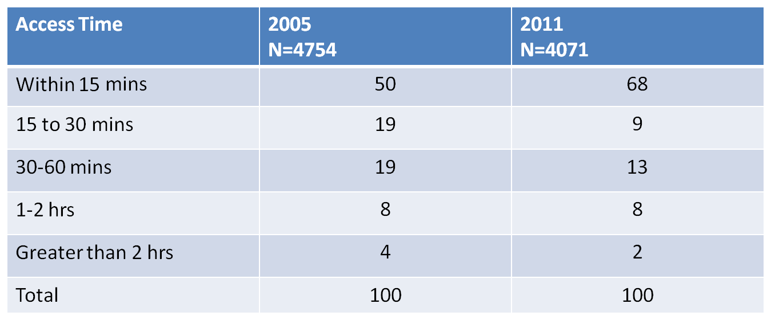
Education Access to Primary Schools

Slide 20
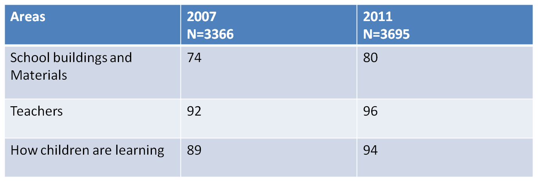
Education Satisfaction with various aspects of Primary Education

Slide 21
Education: Satisfaction with various types of schools

Slide 22
81% of respondents believed that the quality of education was much better, than in previous years(INPS ,2011)

Slide 23
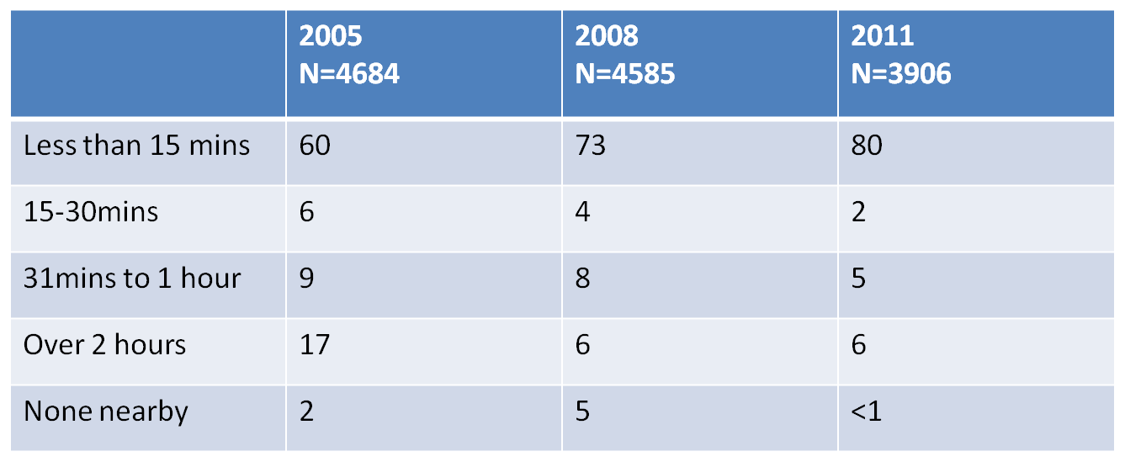
Accessibility: a. Access to a Motorable Road: Distance to a motorable road without transport

Slide 24
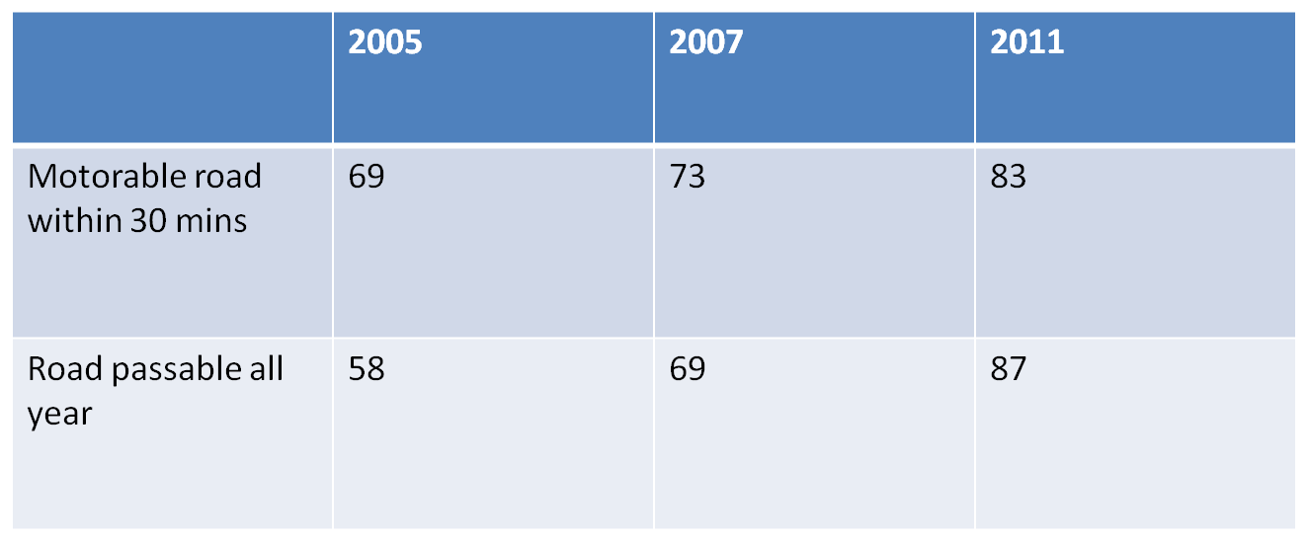
Accessibility-Roads by year

Slide 25
Roads and Communication
Roads:
It is worth noting that up to 2008 , none of the central budget for roads had been decentralized
Councils spent a lot of their resources on improving local roads and access to trunk roads
Central budget focused on improving trunk roads
Communication(2011)
84% of HH in a rural comm. with cell phone coverage
Communities in urban areas report 100% coverage
Cell phone coverage in rural areas increased from 66% in 2007 to 84% in 2011

Slide 26
Water
Water:
Only 8% of HH reported frequent disruptions to the source of their drinking water throughout the year in 2011
The majority of HH(55%) reported getting water from a protected source, up from 48% in 2008

Slide 27
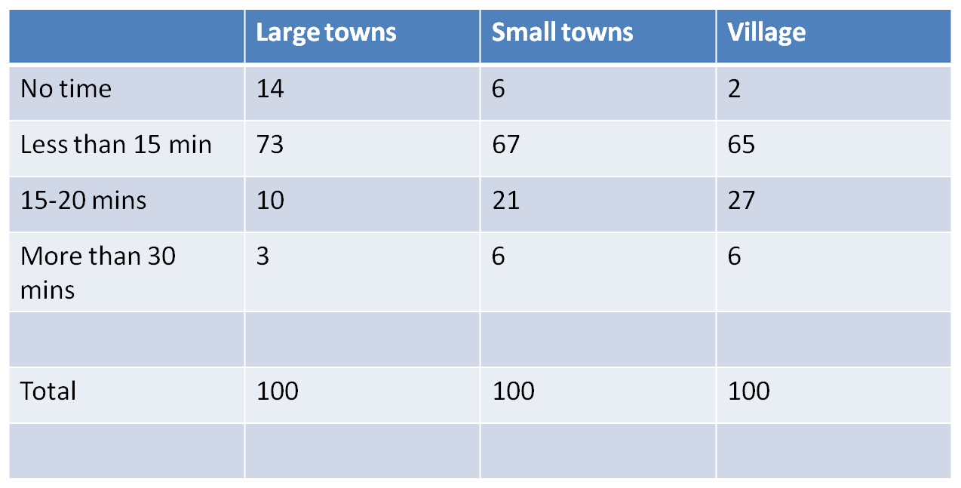
Water

Slide 28
Quotes:
“Ministry of Education staff in Bo shared this view: it was better for education funding to come through the councils rather than directly from the Ministry in Freetown. The local council knows what is happening on the ground ………….”
“Bo District health staff also emphasized that having guaranteed funds enabled them to take pride in their work as health professionals……. and insisted that they would be happy to work in any district of Sierra Leone.”

Slide 29
Quotes:
“FGD participants in all districts were appreciative of recent improvements in local services brought about by decentralization”
“In Kono, the city council was praised for building a new junior secondary school, and the local councils’ school scholarship scheme was also spoken of approvingly.”

Slide 30
6. Challenges
Completing the devolution process as planned
Implementing an over ambitious Devolution plan
Unwillingness by some MDAs to cooperate with the devolution process.
Absence of complete data on personnel and assets in MDAs and in some instances difficult to access.
The lack of a change of mind set by many Government Officials to accept devolution.
Existence of conflicting laws, regulations and procedures.
Some functions are highly technical; even the devolving MDAs lack the resources to carry them.

Slide 31
Challenges….
Sector planning processes for some MDAs is yet to be fully participatory to the extent that plans emanate from the LCs to the Centre.
Inadequate monitoring and supervision from Centre.
Unwillingness of Local Councils to spend local resources on devolved functions.
Late submission of quarterly reports (financial and technical reports) by the Local Councils.
Ensuring that the Inter-Ministerial Committee on Decentralization functions more effectively
Getting the parliamentary Committee on LG to exercise its oversight more effectively

Slide 32
7. The Way Forward
The Government continues to demonstrate strong political will in support of devolution
The Inter-Ministerial Committee (IMC) to be more proactive in its oversight function
Sensitize and educate Ministers, Professional Heads and Politicians on the devolution process.
Strengthen the capacities of the MDAs to perform their post-devolution functions;
Revise the devolution roll-out plans and fix a tight deadline for the completion devolution
Fast-track the review of the LGA04 and other relevant legislation

Slide 33
The Way Forward……
Adopt Asymmetrical devolution
The MLG&RD to be more proactive in following–up on the implementation of devolution roll-out plans to ensure full compliance.
Funding for Devolved Functions to continue go directly to LCs and not sector Ministries/Department/Agencies
The pay roll of personnel to be devolved to the LCs as a matter of urgency.
Frown at any attempts to recentralize/retake functions by MDAs

Slide 34
References
Decentralized Service Delivery in Sierra Leone: A success Story; Christabel Kwabi;2011
Decentralization :What have we learnt?; IRCBP Evaluation Unit;2009
Basic Services and Decentralization in Sierra Leone: Trends and Lessons; Abdul Latif Poverty Action Lab at MIT;2009
Report on the 2008 national Public Services Survey;2010; IRCBP Evaluations Unit

Slide 35
References
Report on IRCBP 2007 National Public Services Survey; 2008; IRCBP Evaluations Unit
Decentralization in Post-conflict Sierra Leone: The Genie Is out of the Bottle; V. Srivastava and M. Larizza
Decentralization in Sierra Leone: Impact, Constraints and Prospects; Richard Fanthorpe, Andrew Lavali, Mohamed Gibril Sesay; 2011
War and Institutions: New Evidence from Sierra Leone; John Bellows and Edward Miguel
Decentralization, Democracy, and Development; Recent Experience from Sierra Leone; Edited by Yongmei Zhou ;The World Bank

